Slide 1


Logistic Regression
HIP 529 Applied Biostatistics II
DATE: March 28, 2022
PRESENTED BY: Emile Latour, MS, Associate Biostatistician, OHSU Knight Cancer Institute
Notes:
https://bit.ly/latour_study-design-and-pss_2022-03-023Mfuydn

Slide 2
Slides are available
https://bit.ly/latour_study-design-and-pss_2022-03-023Mfuydn

Slide 3
Acknowledgement
Meike Niederhausen, PhD, Biostatistics & Design Program (BDP)
Biostatistics, Epidemiology, & Research Design (BERD) Seminar, OCTRI Research Forum
Slides http://bit.ly/BERD-PSS-101
Recording https://echo360.org/media/c14ae529-27fe-4208-ae27-95c7c1adc928/public
Upcoming Thursday March 31, 2022 over Zoom.
Register through Compass: "Power and Sample Size 101"

Slide 4
About me
Pension actuary for 16 years
MS in Biostatistics from OHSU in 2017
Associate Biostatistician with OHSU Knight Cancer Institute since 2016
Long term support for OHSU Dermatology Department since 2018

Slide 5

Goals
Exposure to statistics background on logistic regression models and what sets it apart
Understand terms: log odds, odds ratio, and relative risk
Univariable logistic regression models (association models):
Continuous predictor, categorical predictors
5

Slide 6

Statistical modeling
Notes:
Many statistical methods are centered around summary statistics (means, medians, standard deviation, range…), contingency tables (counts and proportions)
Statistical models though more complicated are actually a more general form of methods you might be familiar with. For example, a t-test or a chi-square test could be considered a special case of a statistical model.

Slide 7
Goal of statistical modeling
To find the best fitting and most parsimonious, yet biologically reasonable model to describe the relationship between an outcome variable and a set of independent variables.
Y. Chen, BSTA 513 Categorical Data Analysis, Spring 2014

Slide 8
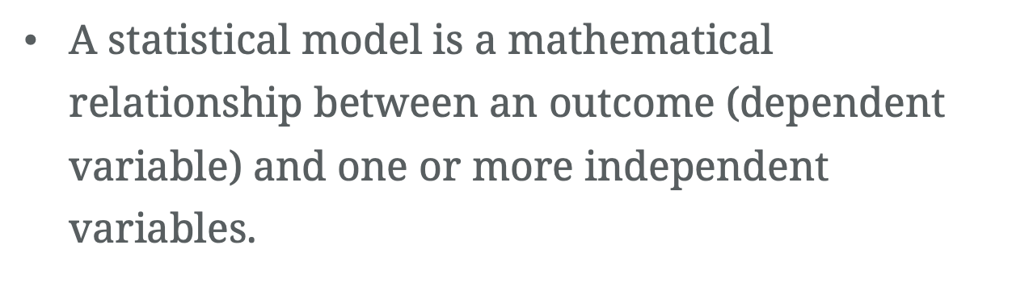
Describe a relationship
$\text{A} \text{statistical} \text{model} \text{is} \text{a} \text{mathematical} \text{relationship} \text{between} \text{an} \text{outcome}\text{ (}\text{dependent} \text{variable}\text{) }\text{and} \text{one} \text{or} \text{more} \text{independent} \text{variables}\text{.}$

Slide 9
Describe a relationship
$\text{A} \text{statistical} \text{model} \text{is} \text{a} \text{mathematical} \text{relationship} \text{between} \text{an} \text{outcome}\text{ (}\text{dependent} \text{variable}\text{) }\text{and} \text{one} \text{or} \text{more} \text{independent} \text{variables}\text{.}$

Slide 10
Types of data / variables
Notes:
Many statistical methods are centered around summary statistics (means, medians, standard deviation, range…), contingency tables (counts and proportions)
Statistical models though more complicated are actually a more general form of methods you might be familiar with. For example, a t-test or a chi-square test could be considered a special case of a statistical model.

Slide 11
Types of data / variables
Discrete (numerical) – quantities or counts, likely with units
Continuous (numerical) -- quantities, likely with units
Ordinal (categorical) – labels with order
Nominal (categorical) – labels with no order
Notes:
Selecting the appropriate methods in statistics requires understanding of the type(s) of data you

Slide 12
Discrete (numerical) data
Actual quantities; not numerical coding of categories
Restricted to a set of isolated points
Intermediate values are impossible
Examples:
Occupants per household: 1, 2, 3, ….
Number of tumors: 0, 1, 2, 3, 4, …
Age to nearest whole year: …, 35, 36, 37, …

Slide 13
Continuous (numerical) data
Actual quantities
Not restricted to a set of isolated points
Intermediate values are(theoretically) possible
Examples:
Change in body weight during pandemic: +19.25 lbs
Cholesterol level: 162 mg/dL
Age (fractional): 35.75 years

Slide 14
Ordinal (categorical) data
Categories or classes with meaningful order
Examples:
Pain: None, Mild, Moderate, Severe
Likert: Disagree, Neutral, Agree
Smoking status: Never, Occasionally, Frequently
Numerical codes can be assigned, but must show the ranking (order)

Slide 15
Nominal (categorical) data
Unordered categories or classes
Examples:
Biological sex: M = Male, F = Female
Blood type: A, B, O, AB
Smoking status: Yes/No (1/0)
Data can be given numerical codes (e.g. 1=A, 2=B, 3=O, 4=AB)

Slide 16
Special case – Binary data
Nominal data with only two levels
Examples: Male/Female, Yes/No, Case/Control, Tx/No Tx
Labels can be replaced with the codes 0 and 1
Sum of the numeric codes gives the total with code 1
The average of the codes gives the proportion (or percentage) assigned the code 1
Example: Sample of n = 10 people coded as smoker (1) or non-smoker (0):
{1, 0, 1, 0, 1, 1, 1, 1, 1, 0}
Total = 7
Average = Total / n = 7 / 10 = 0.70 = 70.0%

Slide 17
Regression models
Notes:
Many statistical methods are centered around summary statistics (means, medians, standard deviation, range…), contingency tables (counts and proportions)
Statistical models though more complicated are actually a more general form of methods you might be familiar with. For example, a t-test or a chi-square test could be considered a special case of a statistical model.

Slide 18
Regression analysis
Mathematically describe the relationship between a dependent variable (outcome) and a set of one or more independent variables

Slide 19
Choosing a model
Most often, the type of data of your outcome will determine the type of model that is used

Slide 20
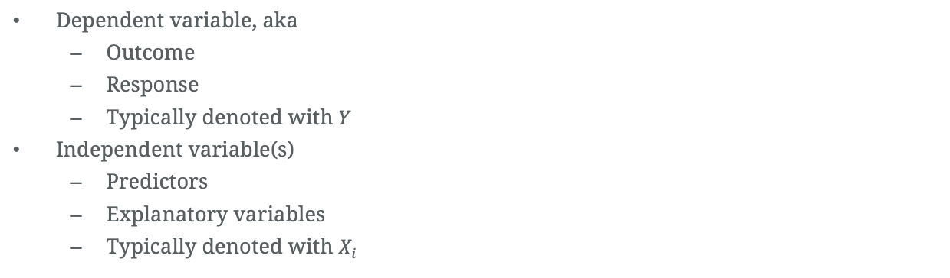
Terms
Dependent variable, aka
Outcome
Response
Typically denoted with $Y$
Independent variable(s)
Predictors
Explanatory variables
Typically denoted with $X_{i}$

Slide 21
Classes of models
“General” Linear models:
Refers to conventional linear regression models
Continuous outcome variable
Continuous and categorical predictors
Also includes multiple linear regression, ANOVA, and ANCOVA
https://online.stat.psu.edu/stat504/lesson/6/6.1

Slide 22
Classes of models
“Generalized” Linear models (GLM):
Broad class of models
Includes ordinary regression/ANOVA models for continuous outcomes
Also, includes models that can handle categorical outcomes

Slide 23
3 components of a GLM
Random component
Systematic component
Link function
https://online.stat.psu.edu/stat504/lesson/6/6.1

Slide 24
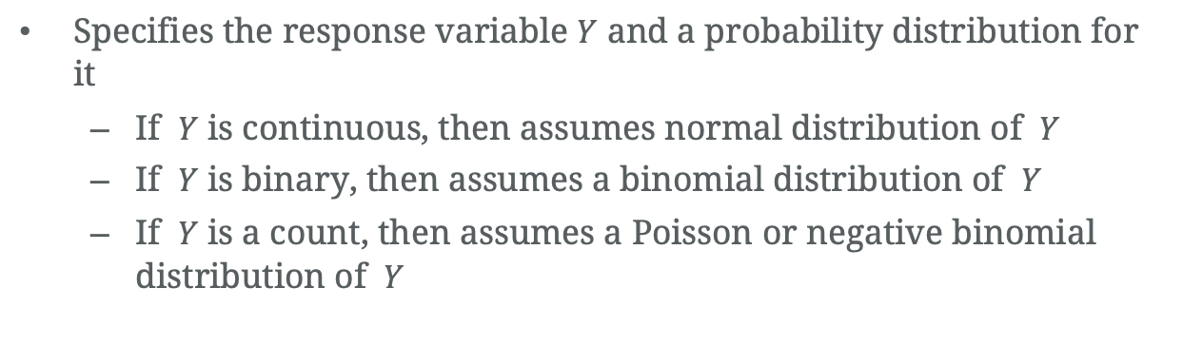
Random component
Specifies the response variable $Y$ and a probability distribution for it
If $Y$ is continuous, then assumes normal distribution of $Y$
If $Y$ is binary, then assumes a binomial distribution of $Y$
If $Y$ is a count, then assumes a Poisson or negative binomial distribution of $Y$
Notes:
Identify Y,
Figure out the type of variable that Y is,
Assume a distribution

Slide 25
Binomial distribution
Success/Failure
Conditions:
The number of trials is fixed (n)
Each trial has one of two outcomes: success or failure
The probability of success (p) is the same for each trial
Trials are independent; the outcome of one trial does not affect the outcome of another

Slide 26
Binomial distribution
Examples
Number of heads out of 20 coin flips
Number of times you hit red light on your commute to work
Number of passengers on the Titanic that survived
Number of patients with a disease in a sample of 1000 patients.
https://shiny.rit.albany.edu/stat/binomial/

Slide 27
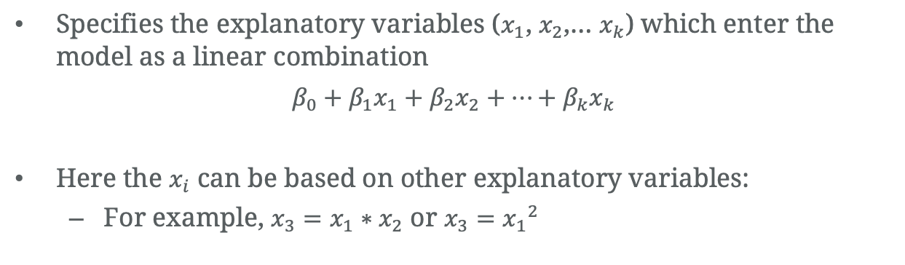
Systematic component
Specifies the explanatory variables ($x_{1}$, $x_{2}$,… $x_{k}$) which enter the model as a linear combination
$$β_{0}+β_{1}x_{1}+β_{2}x_{2}+…+β_{k}x_{k}$$
Here the $x_{i}$ can be based on other explanatory variables:
For example, $x_{3}=x_{1}∗x_{2}$ or $x_{3}={x_{1}}^{2}$

Slide 28
Link function
Connects the predictors in a model with the expected value of the response variable in a linear way
Specifies the link between the random component and the systematic component

Slide 29
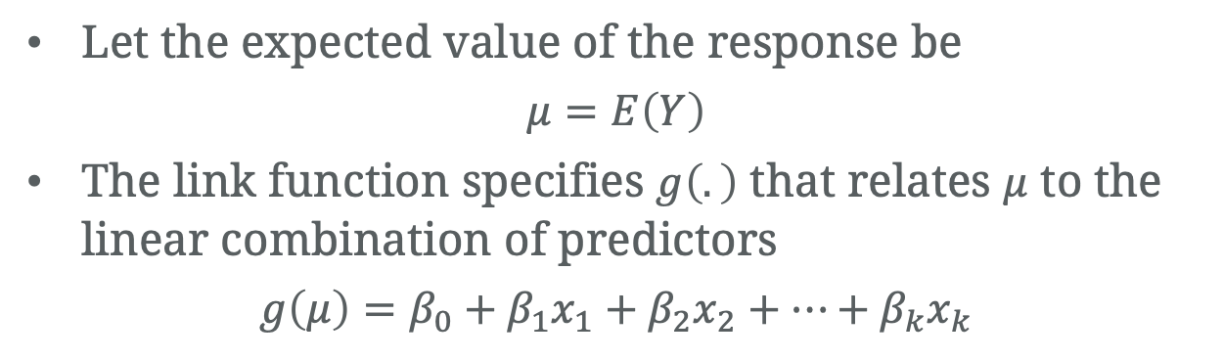
Link function
Let the expected value of the response be
$$μ=E\left(Y\right)$$
The link function specifies $g\left(.\right)$ that relates $μ$ to the linear combination of predictors
$$g\left(μ\right)=β_{0}+β_{1}x_{1}+β_{2}x_{2}+…+β_{k}x_{k}$$
Notes:
It indicates how the expected value of the response relates to the linear combination of explanatory variables; e.g., η=g(E(Yi))=E(Yi) for classical regression, or η=log⁡(π1−π)=logit(π) for logistic regression.
Connects the random component with the systematic component.

Slide 30
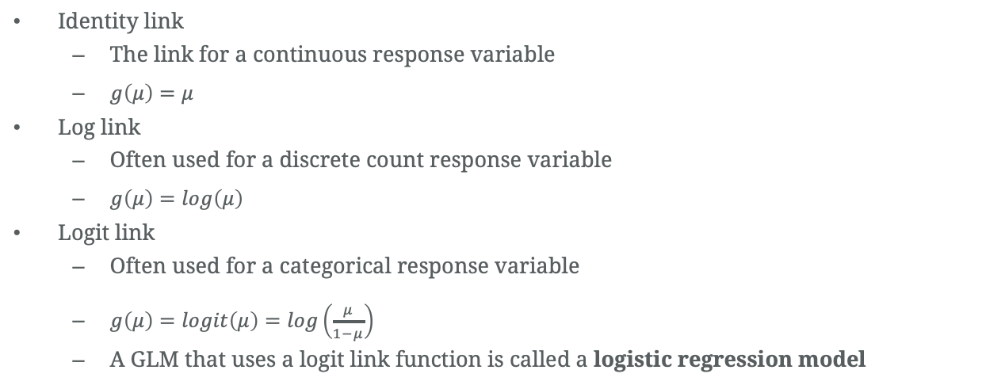
Link function
Identity link
The link for a continuous response variable
$g\left(μ\right)=μ$
Log link
Often used for a discrete count response variable
$g\left(μ\right)=log\left(μ\right)$
Logit link
Often used for a categorical response variable
$g\left(μ\right)=logit\left(μ\right)=log\left(\frac{μ}{1−μ}\right)$
A GLM that uses a logit link function is called a logistic regression model

Slide 31
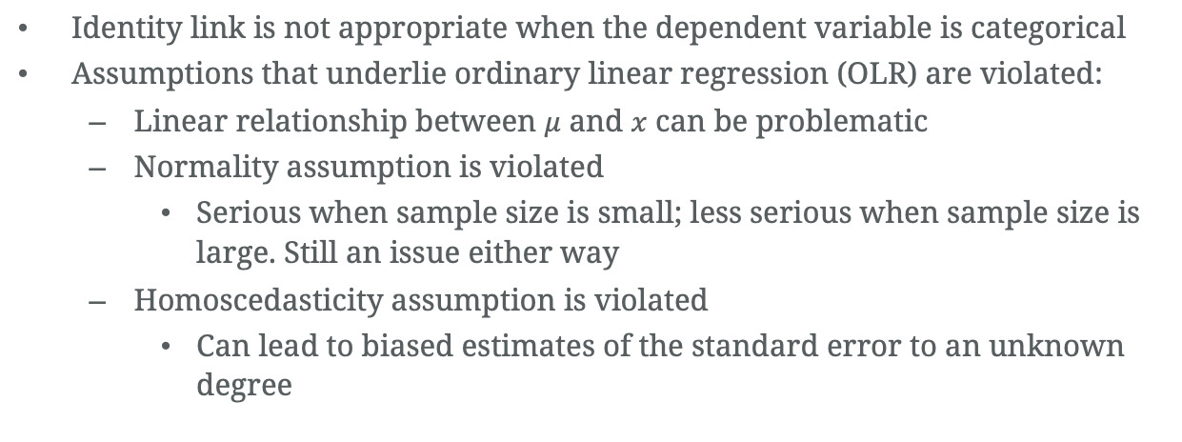
GLM for binary data
Identity link is not appropriate when the dependent variable is categorical
Assumptions that underlie ordinary linear regression (OLR) are violated:
Linear relationship between $μ$ and $x$ can be problematic
Normality assumption is violated
Serious when sample size is small; less serious when sample size is large. Still an issue either way
Homoscedasticity assumption is violated
Can lead to biased estimates of the standard error to an unknown degree

Slide 32
Example
Notes:
Many statistical methods are centered around summary statistics (means, medians, standard deviation, range…), contingency tables (counts and proportions)
Statistical models though more complicated are actually a more general form of methods you might be familiar with. For example, a t-test or a chi-square test could be considered a special case of a statistical model.

Slide 33
CHD Study
A study to evaluate the relationship between age and presence of coronary heart disease (CHD)
Hosmer, D.W., Lemeshow, S. and Sturdivant, R.X. (2013) Applied Logistic Regression, 3rd ed., New York: Wiley

Slide 34
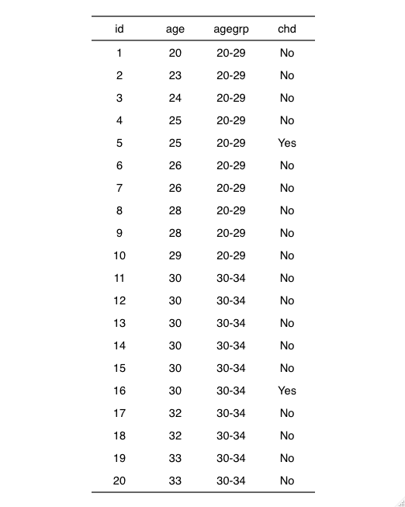
CHD Study
N = 100
First 20 shown here

Slide 35
CHD Study
Primary endpoint (dependent variable): CHD
CHD = “Yes”: patient has coronary heart disease
CHD = “No”: patient does not have coronary heart disease

Slide 36
CHD Study
Primary endpoint (dependent variable): CHD
CHD = “Yes”: patient has coronary heart disease
CHD = “No”: patient does not have coronary heart disease

Slide 37
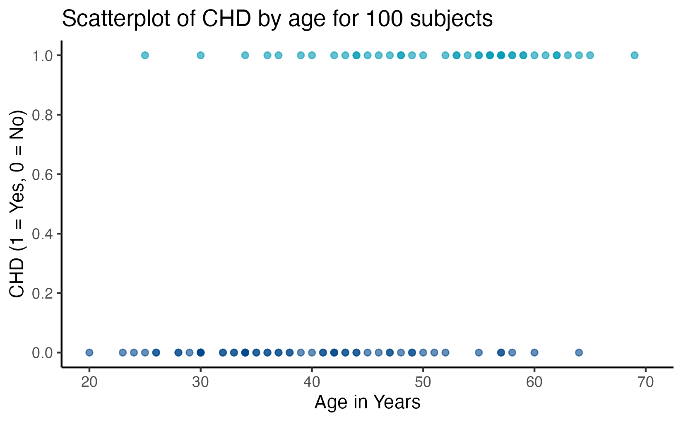
CHD Study

Slide 38
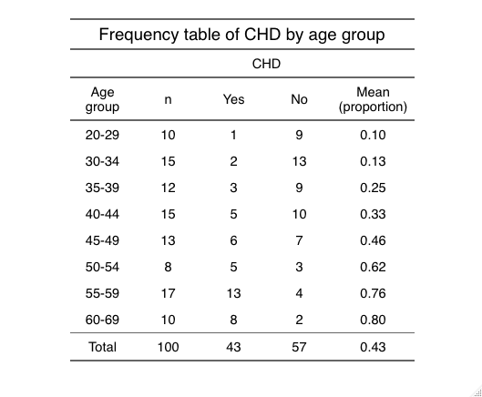
CHD Study

Slide 39
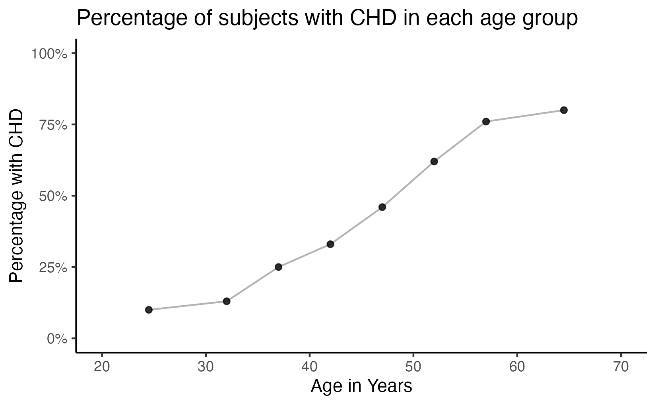
CHD Study
Notes:
Trend – increasing proportion with CHD as age increases
It has a sort of S shape
Flat on the two ends
Doesn’t quite look linear

Slide 40
CHD Study
Apparent trend: increasing proportion with CHD as age increases
Relationship does not look linear in the two ends

Slide 41
Making things linear

Slide 42
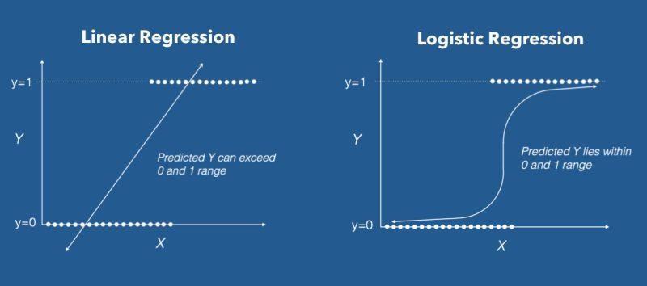
Another look at the issue
https://www.datacamp.com/community/tutorials/logistic-regression-R

Slide 43
Issue
We have binary data
We want to be able to run something like a regression
But where we model the probability of the outcome

Slide 44
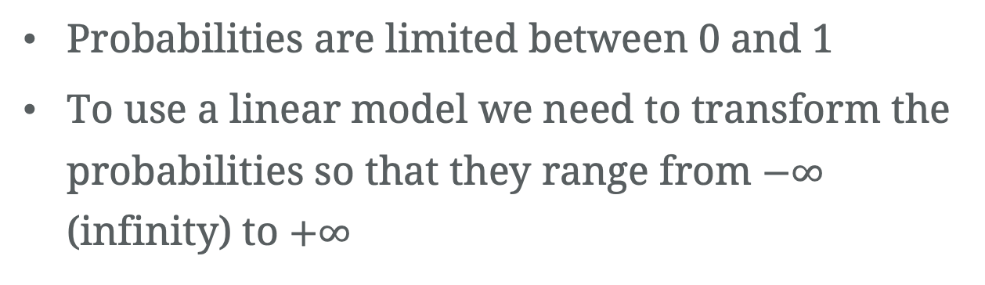
Issue and solution
Probabilities are limited between 0 and 1
To use a linear model we need to transform the probabilities so that they range from $−∞$ (infinity) to $+∞$

Slide 45
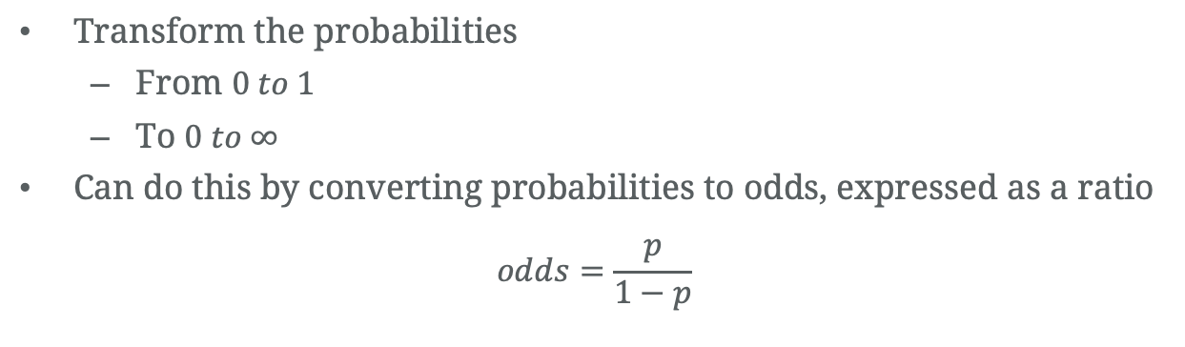
Odds
Transform the probabilities
From $0 to 1$
To $0 to ∞$
Can do this by converting probabilities to odds, expressed as a ratio
$$odds=\frac{p}{1−p}$$

Slide 46
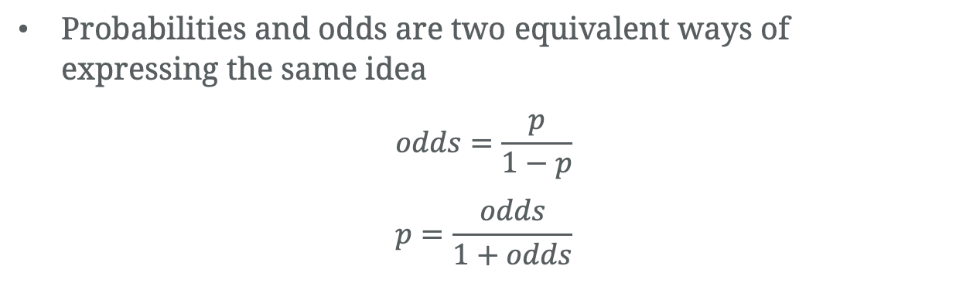
Odds
Probabilities and odds are two equivalent ways of expressing the same idea
$$odds=\frac{p}{1−p}$$
$$p=\frac{odds}{1+odds}$$
Notes:
Same idea but probability and odds are different things

Slide 47
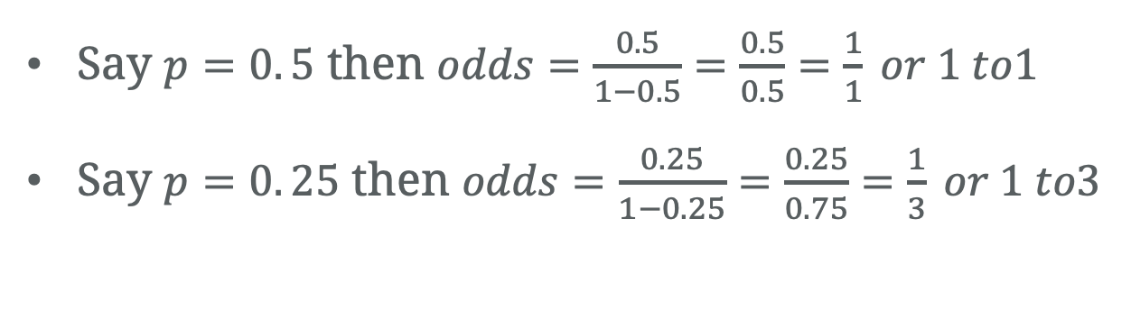
Odds
Say $p=0. 5$ then $odds=\frac{0.5}{1−0.5}=\frac{0.5}{0.5}=\frac{1}{1} or 1 to1$
Say $p=0. 25$ then $odds=\frac{0.25}{1−0.25}=\frac{0.25}{0.75}=\frac{1}{3} or 1 to3$

Slide 48
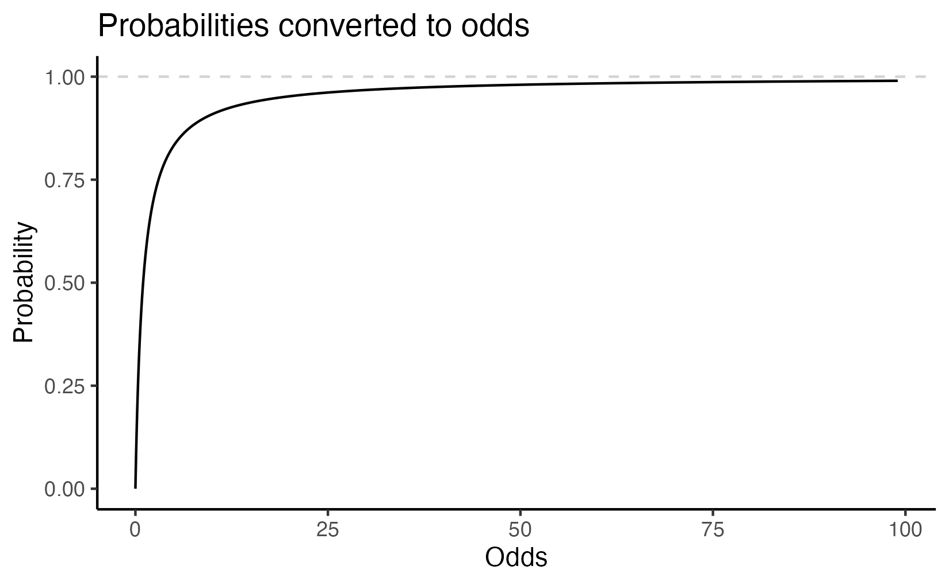
Odds
Notes:
When the probability is zero, the odds are zero
When the probability approaches 1, the odds approach infinity
Close to what we would want for regression
Looks a lot like the top half of the S curve we saw earlier

Slide 49
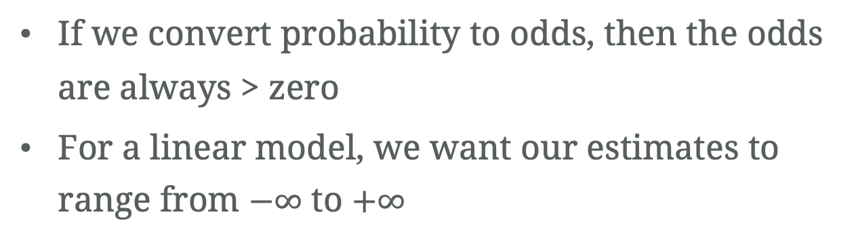
Odds
If we convert probability to odds, then the odds are always > zero
For a linear model, we want our estimates to range from $−∞$ to $+∞$

Slide 50
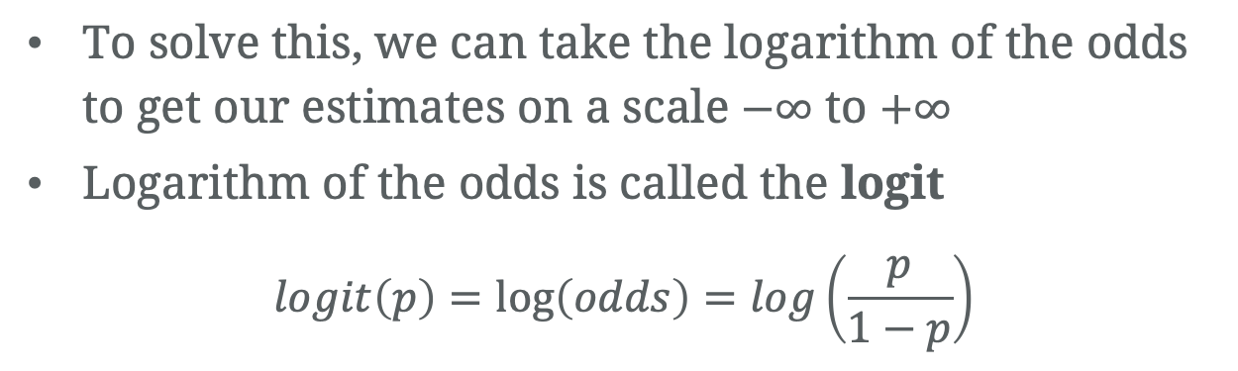
Log odds
To solve this, we can take the logarithm of the odds to get our estimates on a scale $−∞$ to $+∞$
Logarithm of the odds is called the logit
$$logit\left(p\right)=\log\left(odds\right)=log\left(\frac{p}{1−p}\right)$$

Slide 51
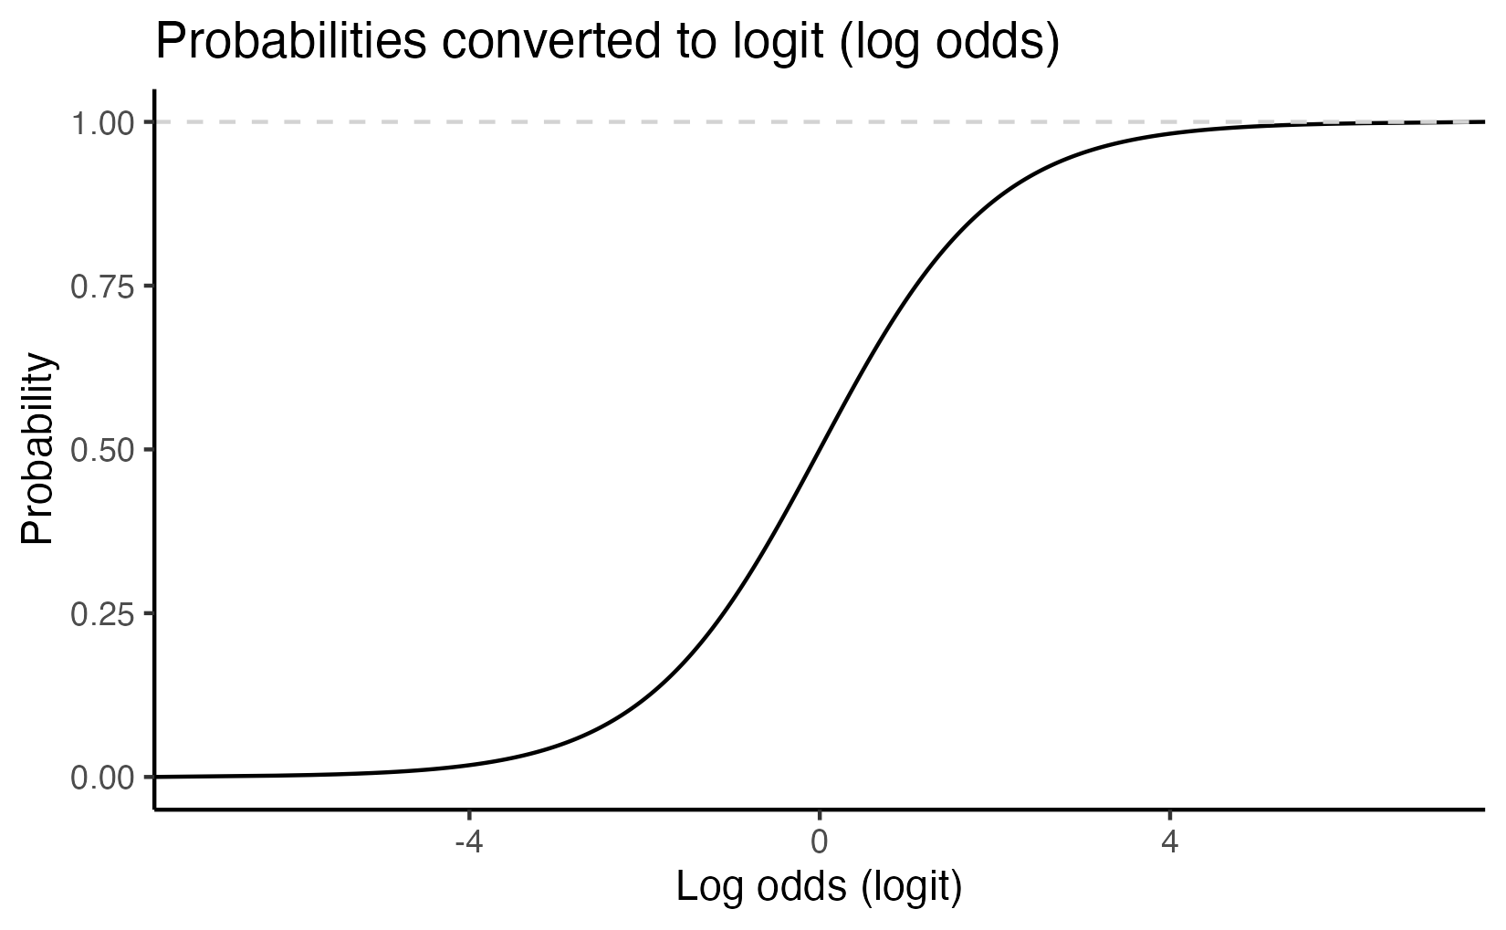
Logit
Notes:
The figure shows the transformation of probabilities between 0 and 1 to the log-odds scale. The logit has two nice properties:
It converts odds of less than one to negative numbers, because the log of a number between 0 and 1 is always negative[^1].
It flattens the rather square curve for the odds in the figure above, and

Slide 52
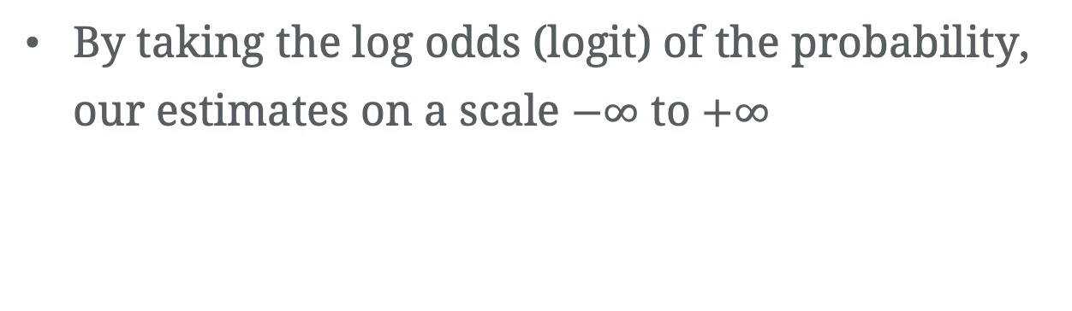
Logit
By taking the log odds (logit) of the probability, our estimates on a scale $−∞$ to $+∞$

Slide 53
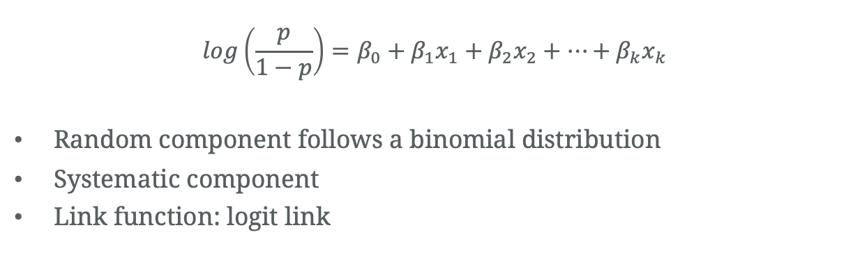
Logistic regression model
$$log\left(\frac{p}{1−p}\right)=β_{0}+β_{1}x_{1}+β_{2}x_{2}+…+β_{k}x_{k}$$
Random component follows a binomial distribution
Systematic component
Link function: logit link

Slide 54
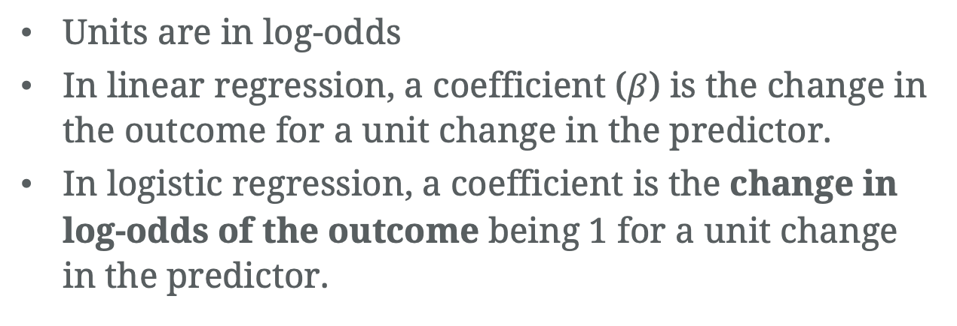
Logistic regression model
Units are in log-odds
In linear regression, a coefficient ($β$) is the change in the outcome for a unit change in the predictor.
In logistic regression, a coefficient is the change in log-odds of the outcome being 1 for a unit change in the predictor.

Slide 55
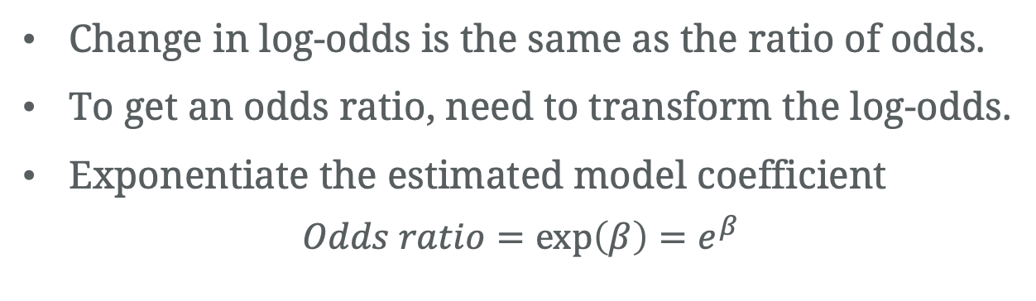
Logistic regression model
Change in log-odds is the same as the ratio of odds.
To get an odds ratio, need to transform the log-odds.
Exponentiate the estimated model coefficient
$$Odds ratio=\exp\left(β\right)=e^{β}$$
https://benwhalley.github.io/just-enough-r/link-functions.html

Slide 56
Simple logistic regression

Slide 57
Hip fracture study
A study to examine the relationship between hip fracture with age, sex, BMI, and bone mineral density (bone densitometries).
https://bookdown.org/tpinto_home/Regression-and-Classification/#datasets-used-in-the-examples

Slide 58
Hip fracture study
id: subject ID
age: subject age in years
sex: biological sex (Female/Male)
fracture: hip fracture (Fracture/Nofracture)
weight_kg: weight in kg
height_cm: height in cm
medication: prescribed medications
waiting_time: time the subject waited for the densitometry (in minutes)
bmd: bone mineral density measure in the hip
bmi: calculated body mass index
bmi_c: Body mass index category (Underweight, Healthy, Overweight, Obese)
https://bookdown.org/tpinto_home/Regression-and-Classification/#datasets-used-in-the-examples

Slide 59
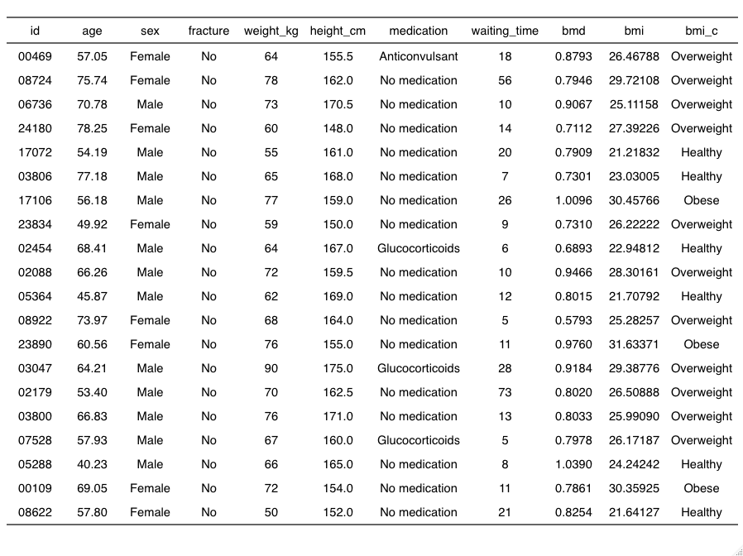
N = 169; First 20 shown below

Slide 60
Hip fracture Study
Primary endpoint (dependent variable): fracture
fracture = “Yes”: patient had a hip fracture
fracture = “No”: patient did not have hip fracture

Slide 61
Fracture and age
Research question #1:
Is there a relationship between a hip fracture occurring and age?

Slide 62
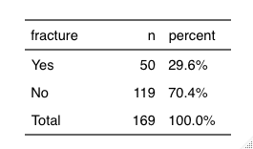
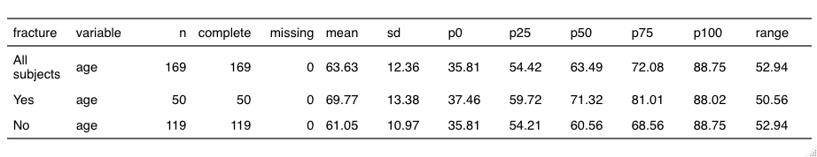
Fracture and age

Slide 63
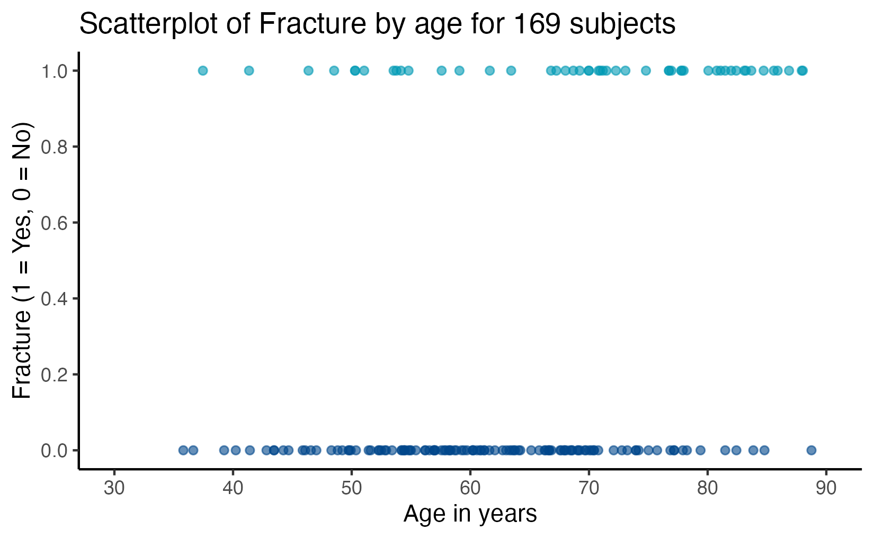
Fracture and age

Slide 64
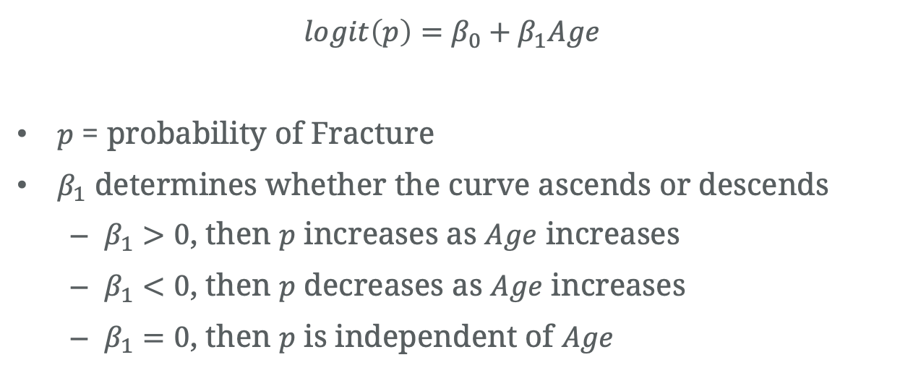
Fracture and age
$$logit\left(p\right)=β_{0}+β_{1}Age$$
$p$ = probability of Fracture
$β_{1}$ determines whether the curve ascends or descends
$β_{1}>0$, then $p$ increases as $Age$ increases
$β_{1}<0$, then $p$ decreases as $Age$ increases
$β_{1}=0$, then $p$ is independent of $Age$

Slide 65
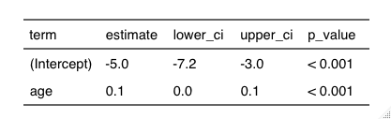
Fracture and age – log-odds
Interpretation: For every one unit increase in age, the log-odds of fracture occurring increases on average by 0.1 units (95% CI: 0.0 to 0.1 units increase in log-odds). There is a statistically significant association between hip fracture and age (P < 0.001).
Notes:
For example, a one unit increase in the predictor variable disp is associated with an average change of -0.09518 in the log odds of the response variable am taking on a value of 1. This means that higher values of disp are associated with a lower likelihood of the am variable taking on a value of 1.

Slide 66
Fracture and age – log-odds
> res <- glm((fracture == "Yes") ~ age,
+ family = binomial(link = "logit"),
+ data = data)
> summary(res)
Call:
glm(formula = (fracture == "Yes") ~ age, family = binomial(link = "logit"),
data = data)
Deviance Residuals:
Min 1Q Median 3Q Max
-1.4444 -0.8553 -0.6216 1.0699 2.3290
Coefficients:
Estimate Std. Error z value Pr(>|z|)
(Intercept) -5.01863 1.07672 -4.661 3.15e-06 ***
age 0.06341 0.01583 4.007 6.16e-05 ***
---
Signif. codes: 0 ‘***’ 0.001 ‘**’ 0.01 ‘*’ 0.05 ‘.’ 0.1 ‘ ’ 1
(Dispersion parameter for binomial family taken to be 1)
Null deviance: 205.27 on 168 degrees of freedom
Residual deviance: 186.76 on 167 degrees of freedom
AIC: 190.76
Number of Fisher Scoring iterations: 4

Slide 67
Fracture and age – log-odds
. logit fracture age
Iteration 0: log likelihood = -102.63604
Iteration 1: log likelihood = -93.602157
Iteration 2: log likelihood = -93.378565
Iteration 3: log likelihood = -93.37797
Iteration 4: log likelihood = -93.37797
Logistic regression Number of obs = 169
LR chi2(1) = 18.52
Prob > chi2 = 0.0000
Log likelihood = -93.37797 Pseudo R2 = 0.0902
------------------------------------------------------------------------------
fracture | Coef. Std. Err. z P>|z| [95% Conf. Interval]
-------------+----------------------------------------------------------------
age | .0634076 .0158255 4.01 0.000 .0323902 .094425
_cons | -5.018625 1.07672 -4.66 0.000 -7.128958 -2.908293
------------------------------------------------------------------------------

Slide 68
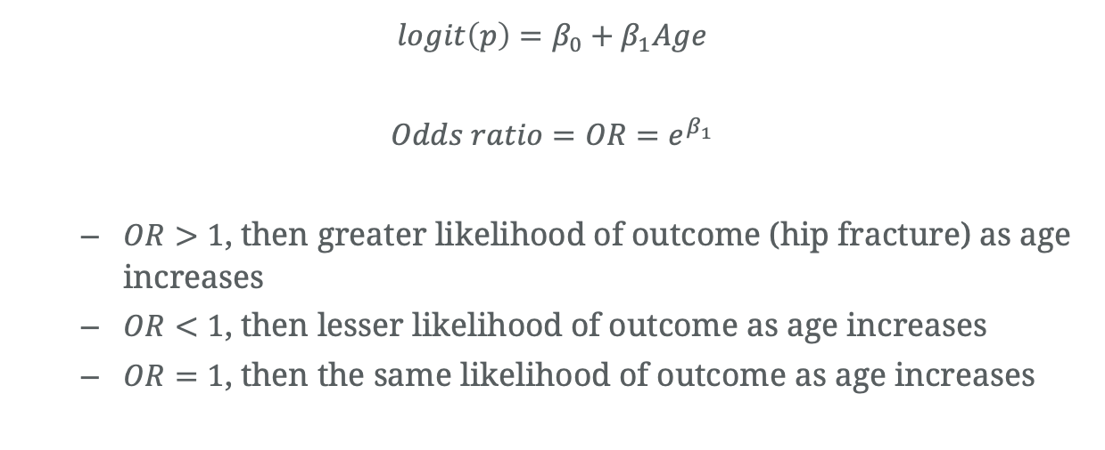
Fracture and age – odds ratio
$$logit\left(p\right)=β_{0}+β_{1}Age$$
$$Odds ratio=OR=e^{β_{1}}$$
$OR>1$, then greater likelihood of outcome (hip fracture) as age increases
$OR<1$, then lesser likelihood of outcome as age increases
$OR=1$, then the same likelihood of outcome as age increases

Slide 69
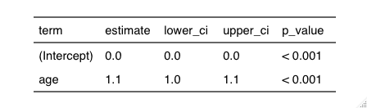
Fracture and age –odds ratio
Interpretation: For every one unit increase in age, the odds of fracture occurring increases 1.1 times (95% CI: 1.0 to 1.1 times). There is a statistically significant association between hip fracture and age (P < 0.001).

Slide 70
Fracture and age –odds ratio
> res <- glm((fracture == "Yes") ~ age,
+ family = binomial(link = "logit"),
+ data = data)
> exp(cbind(OR = coef(res), confint(res)))
Waiting for profiling to be done...
OR 2.5 % 97.5 %
(Intercept) 0.00661361 0.0007122222 0.0494659
age 1.06546105 1.0341146816 1.1006313

Slide 71
Fracture and age –odds ratio
. logit fracture age, or
Iteration 0: log likelihood = -102.63604
Iteration 1: log likelihood = -93.602157
Iteration 2: log likelihood = -93.378565
Iteration 3: log likelihood = -93.37797
Iteration 4: log likelihood = -93.37797
Logistic regression Number of obs = 169
LR chi2(1) = 18.52
Prob > chi2 = 0.0000
Log likelihood = -93.37797 Pseudo R2 = 0.0902
------------------------------------------------------------------------------
fracture | Odds Ratio Std. Err. z P>|z| [95% Conf. Interval]
-------------+----------------------------------------------------------------
age | 1.065461 .0168614 4.01 0.000 1.03292 1.099027
_cons | .0066136 .007121 -4.66 0.000 .0008016 .0545688
------------------------------------------------------------------------------

Slide 72
Fracture and sex
Research question #2:
Is there a relationship between a hip fracture occurring and biological sex?

Slide 73
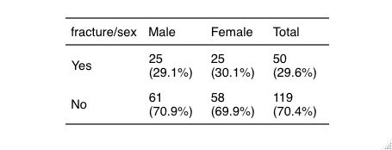
Fracture and sex

Slide 74
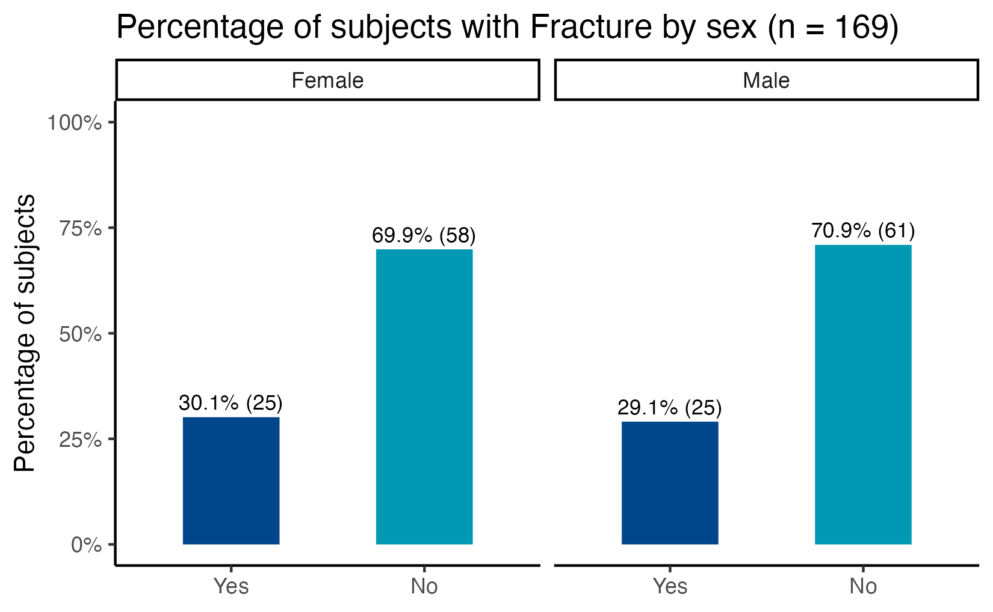
Fracture and sex

Slide 75
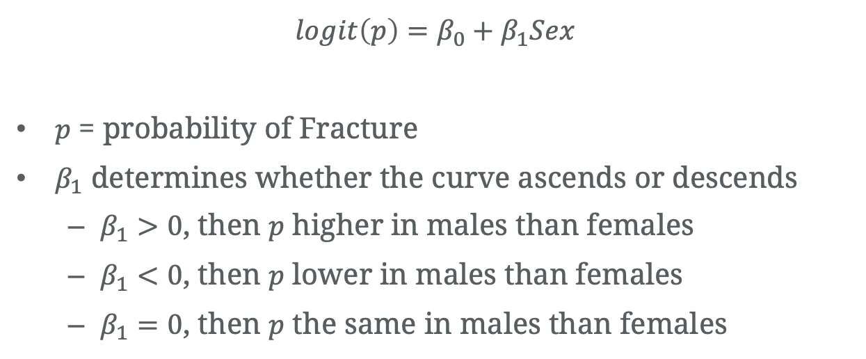
Fracture and sex
$$logit\left(p\right)=β_{0}+β_{1}Sex$$
$p$ = probability of Fracture
$β_{1}$ determines whether the curve ascends or descends
$β_{1}>0$, then $p$ higher in males than females
$β_{1}<0$, then $p$ lower in males than females
$β_{1}=0$, then $p$ the same in males than females

Slide 76
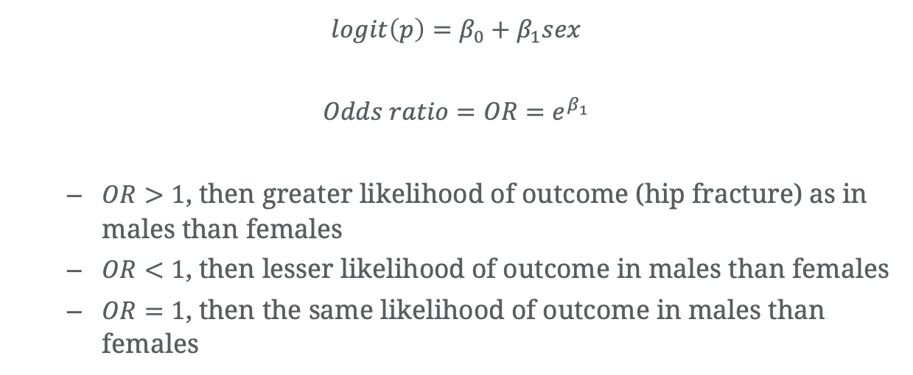
Fracture and sex – odds ratio
$$logit\left(p\right)=β_{0}+β_{1}sex$$
$$Odds ratio=OR=e^{β_{1}}$$
$OR>1$, then greater likelihood of outcome (hip fracture) as in males than females
$OR<1$, then lesser likelihood of outcome in males than females
$OR=1$, then the same likelihood of outcome in males than females

Slide 77
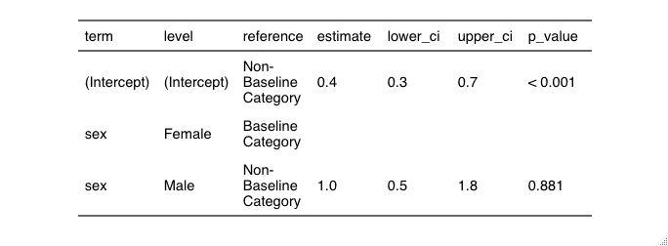
Fracture and sex
Interpretation: The odds of hip fracture among male subjects is 1.0 times (95% CI: 0.5 to 1.8 times) the odds of hip fracture among female subjects. There is no statistically significant association between hip fracture and sex (P < 0.881).

Slide 78
Fracture and sex
> res <- glm((fracture == "Yes") ~ sex,
+ family = binomial(link = "logit"),
+ data = data)
> summary(res)
Call:
glm(formula = (fracture == "Yes") ~ sex, family = binomial(link = "logit"),
data = data)
Deviance Residuals:
Min 1Q Median 3Q Max
-0.8466 -0.8466 -0.8288 1.5492 1.5719
Coefficients:
Estimate Std. Error z value Pr(>|z|)
(Intercept) -0.84157 0.23925 -3.517 0.000436 ***
sexMale -0.05043 0.33710 -0.150 0.881078
---
Signif. codes: 0 ‘***’ 0.001 ‘**’ 0.01 ‘*’ 0.05 ‘.’ 0.1 ‘ ’ 1
(Dispersion parameter for binomial family taken to be 1)
Null deviance: 205.27 on 168 degrees of freedom
Residual deviance: 205.25 on 167 degrees of freedom
AIC: 209.25
Number of Fisher Scoring iterations: 4
> ## odds ratios and 95% CI
> exp(cbind(OR = coef(res), confint(res)))
Waiting for profiling to be done...
OR 2.5 % 97.5 %
(Intercept) 0.4310345 0.2651600 0.6804247
sexMale 0.9508197 0.4898953 1.8448256

Slide 79
Fracture and sex
. logit fracture i.sex, or
Iteration 0: log likelihood = -102.63604
Iteration 1: log likelihood = -102.62485
Iteration 2: log likelihood = -102.62485
Logistic regression Number of obs = 169
LR chi2(1) = 0.02
Prob > chi2 = 0.8811
Log likelihood = -102.62485 Pseudo R2 = 0.0001
------------------------------------------------------------------------------
fracture | Odds Ratio Std. Err. z P>|z| [95% Conf. Interval]
-------------+----------------------------------------------------------------
sex |
Male | .9508197 .3205191 -0.15 0.881 .4910889 1.840925
_cons | .4310345 .1031257 -3.52 0.000 .2696874 .6889115
------------------------------------------------------------------------------

Slide 80
Reference levels
For interpretation it’s vital to know which level of a variable is the Reference Level.
The level of a categorical variable considered the “baseline” or “usual” value
Other levels are compared to the Reference Level

Slide 81
Reference levels
In the Fracture and Sex example, Female is the reference level.
The models give us an odds ratio for the Male level.
Odds ratio is in terms of Male compared to Female.

Slide 82
Reference levels
When in doubt, check it.
Can do this “by hand” with a 2x2 table.

Slide 83
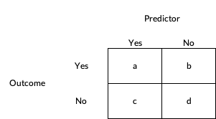
Odds ratio – 2x2 table

Slide 84
Odds ratio – 2x2 table
a = 25
b = 25
c = 61
d = 58

Slide 85
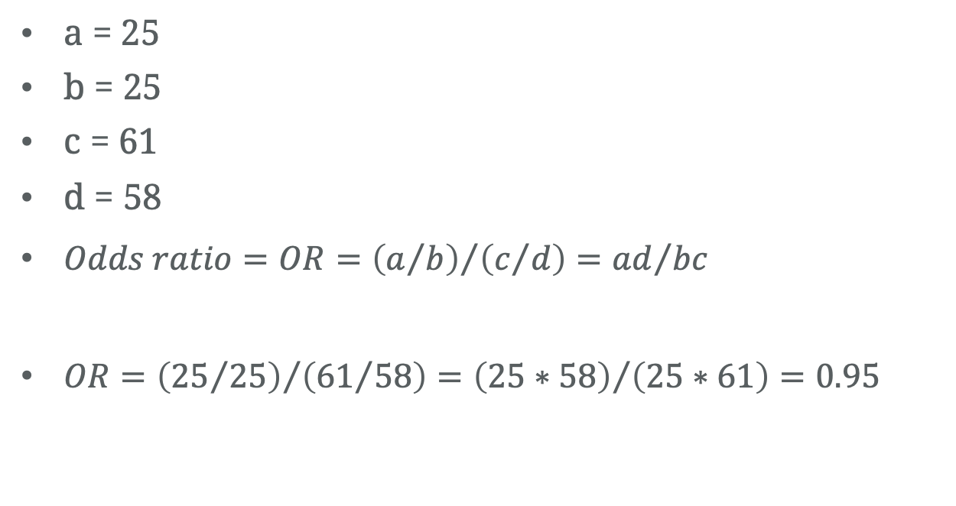
Odds ratio – 2x2 table
a = 25
b = 25
c = 61
d = 58
$Odds ratio=OR={\left(a/b\right)}/{\left(c/d\right)}={ad}/{bc}$
$OR={\left({25}/{25}\right)}/{\left({61}/{58}\right)}={\left(25∗58\right)}/{\left(25∗61\right)=0.95}$

Slide 86
Odds ratio – 2x2 table
The odds of [outcome = “Yes”] among those [predictor = “Yes”] is [odds ratio] times the odds of those with [predictor = “No].

Slide 87
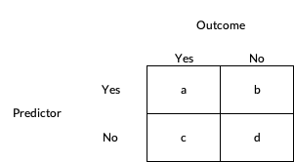
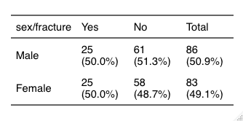
Odds ratio – 2x2 table

Slide 88
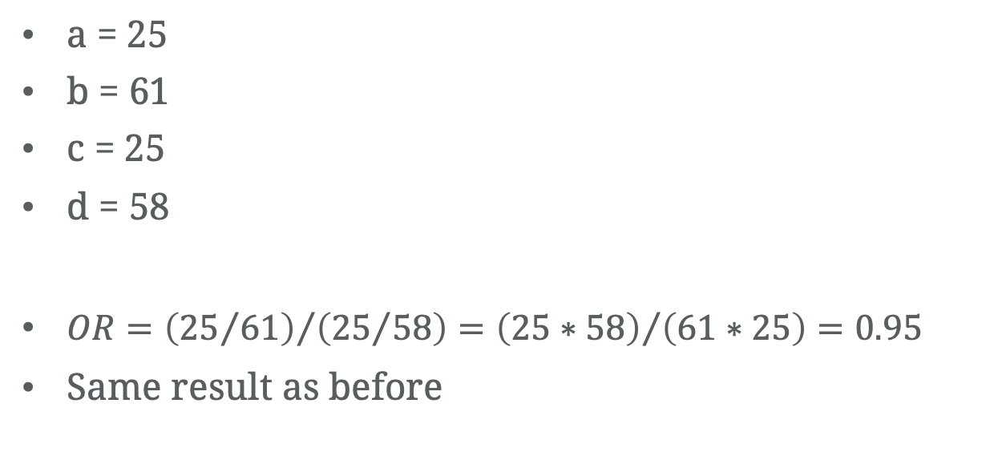
Odds ratio – 2x2 table
a = 25
b = 61
c = 25
d = 58
$OR={\left({25}/{61}\right)}/{\left({25}/{58}\right)}={\left(25∗58\right)}/{\left(61∗25\right)=0.95}$
Same result as before
Notes:
a/b / c/d = a*d / b*c

Slide 89
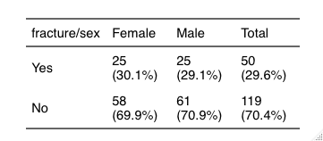
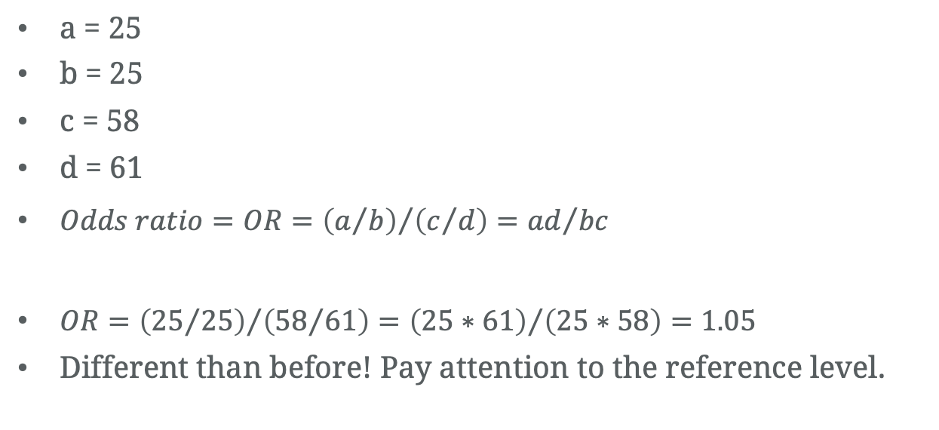
Change the reference level – 2x2 table
a = 25
b = 25
c = 58
d = 61
$Odds ratio=OR={\left(a/b\right)}/{\left(c/d\right)}={ad}/{bc}$
$OR={\left({25}/{25}\right)}/{\left({58}/{61}\right)}={\left(25∗61\right)}/{\left(25∗58\right)=1.05}$
Different than before! Pay attention to the reference level.

Slide 90
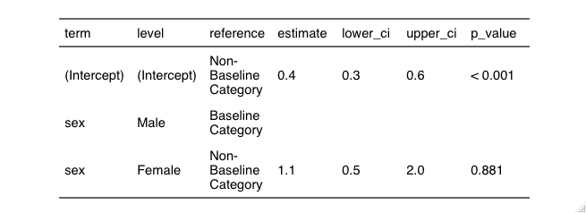
Change the reference level – LR Model

Slide 91
Fracture and BMI
Research question #2:
Is there a relationship between a hip fracture occurring and BMI?

Slide 92
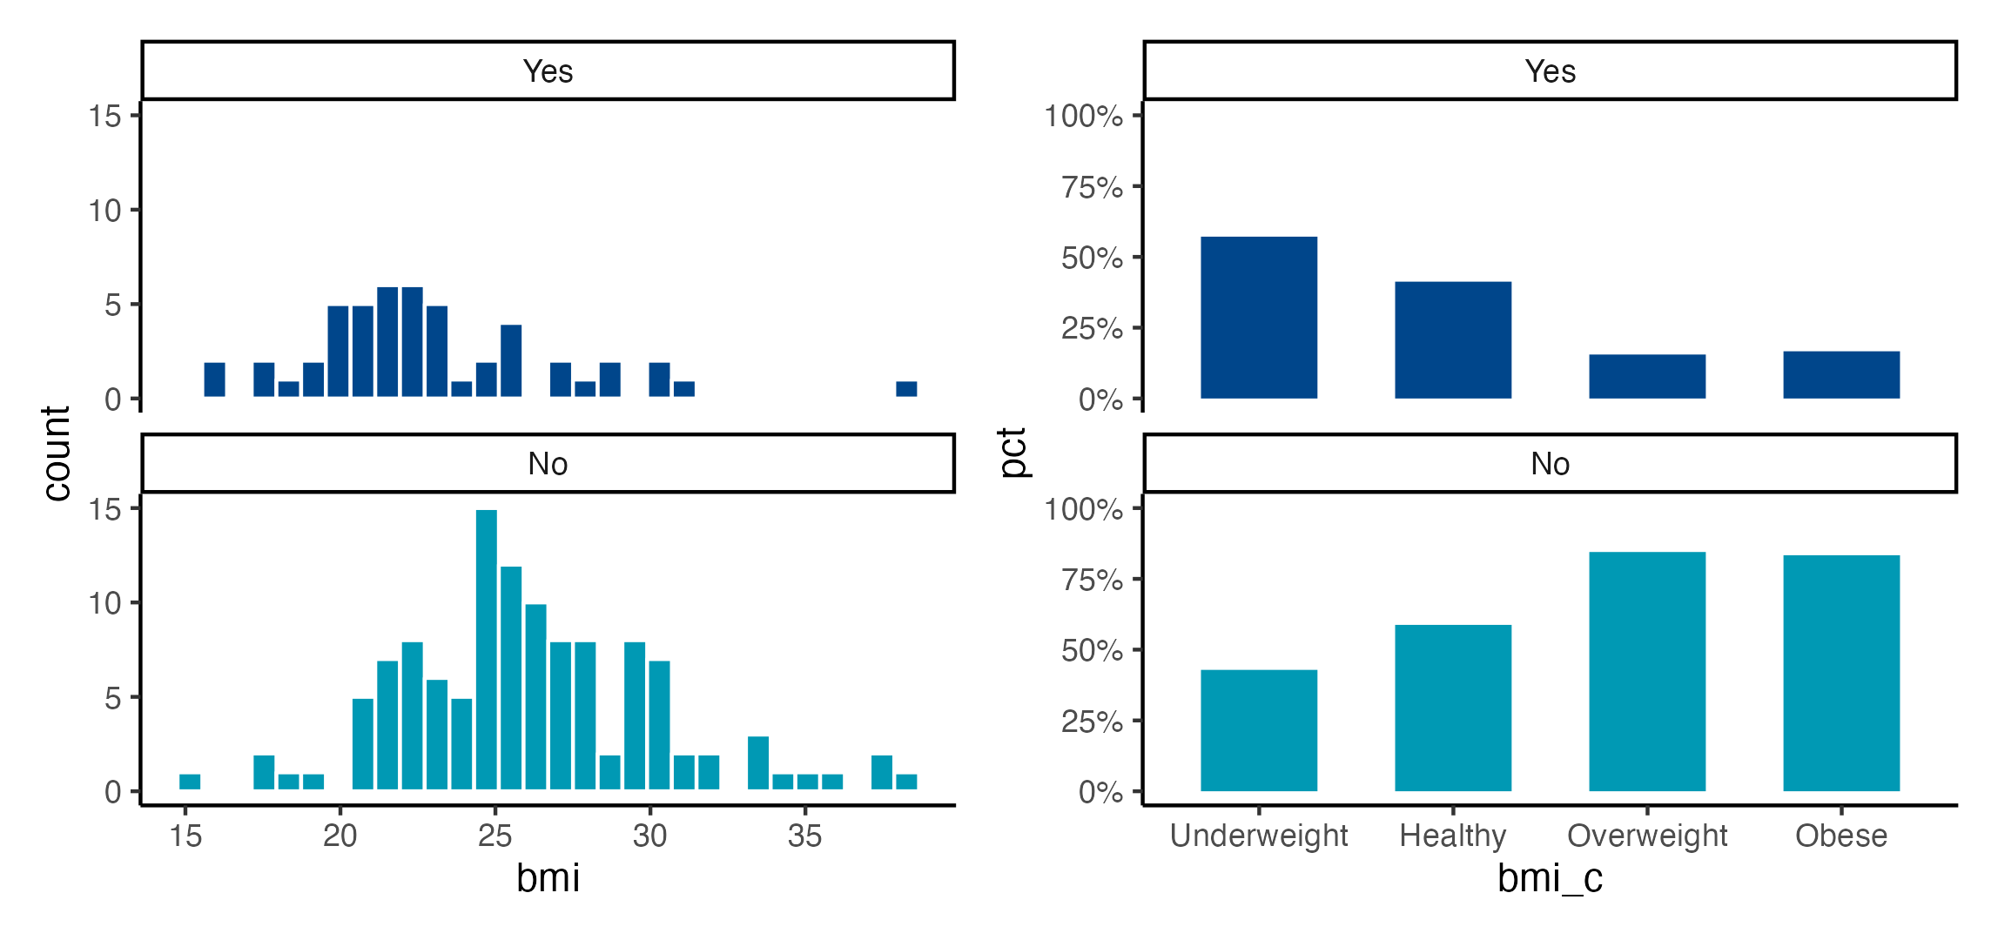
BMI – continuous or categorical?

Slide 93
Fracture and BMI
Categorical BMI
“Healthy” is the reference level

Slide 94
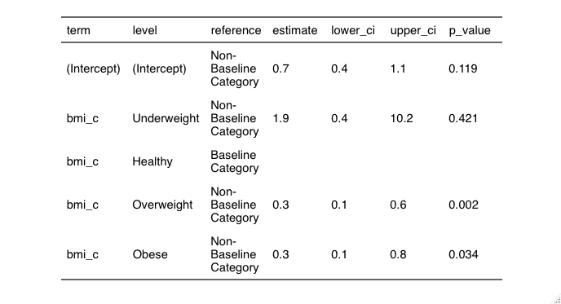
Fracture and BMI

Slide 95
Fracture and BMI
Interpret relative to the Reference Level
Compared to Healthy subjects, Underweight subjects were 1.9 times (95% CI: 0.4 to 10.2 times) more likely to have hip fracture (P = 0.421).
The odds of hip fracture among Overweight subjects was 0.3 times (95% CI: 0.1 to 0.6 times) the odds of hip fracture among Healthy subjects. Overweight subjects were less likely to experience hip fracture (P = 0.002).

Slide 96
Fracture and BMI
> data$bmi_c <- relevel(data$bmi_c, ref = "Healthy")
> res <- glm((fracture == "Yes") ~ bmi_c,
+ family = binomial(link = "logit"),
+ data = data)
> summary(res)
Call:
glm(formula = (fracture == "Yes") ~ bmi_c, family = binomial(link = "logit"),
data = data)
Deviance Residuals:
Min 1Q Median 3Q Max
-1.3018 -1.0314 -0.5807 1.3308 1.9304
Coefficients:
Estimate Std. Error z value Pr(>|z|)
(Intercept) -0.3536 0.2271 -1.557 0.11944
bmi_cUnderweight 0.6413 0.7968 0.805 0.42090
bmi_cOverweight -1.3410 0.4279 -3.134 0.00173 **
bmi_cObese -1.2558 0.5929 -2.118 0.03418 *
---
Signif. codes: 0 ‘***’ 0.001 ‘**’ 0.01 ‘*’ 0.05 ‘.’ 0.1 ‘ ’ 1
(Dispersion parameter for binomial family taken to be 1)
Null deviance: 205.27 on 168 degrees of freedom
Residual deviance: 189.69 on 165 degrees of freedom
AIC: 197.69
Number of Fisher Scoring iterations: 4
> ## odds ratios and 95% CI
> exp(cbind(OR = coef(res), confint(res)))
Waiting for profiling to be done...
OR 2.5 % 97.5 %
(Intercept) 0.7021277 0.44643887 1.0914867
bmi_cUnderweight 1.8989899 0.39391648 10.1755229
bmi_cOverweight 0.2615955 0.10772680 0.5853194
bmi_cObese 0.2848485 0.07743896 0.8363863

Slide 97
Fracture and BMI
. logit fracture ib1.bmi_c2, or
Iteration 0: log likelihood = -102.63604
Iteration 1: log likelihood = -95.007409
Iteration 2: log likelihood = -94.846001
Iteration 3: log likelihood = -94.845749
Iteration 4: log likelihood = -94.845749
Logistic regression Number of obs = 169
LR chi2(3) = 15.58
Prob > chi2 = 0.0014
Log likelihood = -94.845749 Pseudo R2 = 0.0759
------------------------------------------------------------------------------
fracture | Odds Ratio Std. Err. z P>|z| [95% Conf. Interval]
-------------+----------------------------------------------------------------
bmi_c2 |
Obese | .2848485 .1688985 -2.12 0.034 .0891048 .9105979
Overweight | .2615955 .1119369 -3.13 0.002 .1130839 .6051457
Underweight | 1.89899 1.513142 0.80 0.421 .3983576 9.052576
|
_cons | .7021277 .1594613 -1.56 0.119 .4498818 1.095806
------------------------------------------------------------------------------

Slide 98
Odds and ends
Relative Risk
In case control studies and cohort studies where the outcome occurs in less than 10% of the exposed population, Odds Ratio provides a reasonable approximation to the Relative Risk
Odds ratios and risk ratios: what's the difference and why does it matter? (Viera)

Slide 99
Odds and ends
Association vs. Prediction
Models we have seen here are focused on associations – relationships and interpretations
Prediction/classification – aims to predict. Topic for another time
Classification versus association models: Should the same methods apply? (Feng)

Slide 100
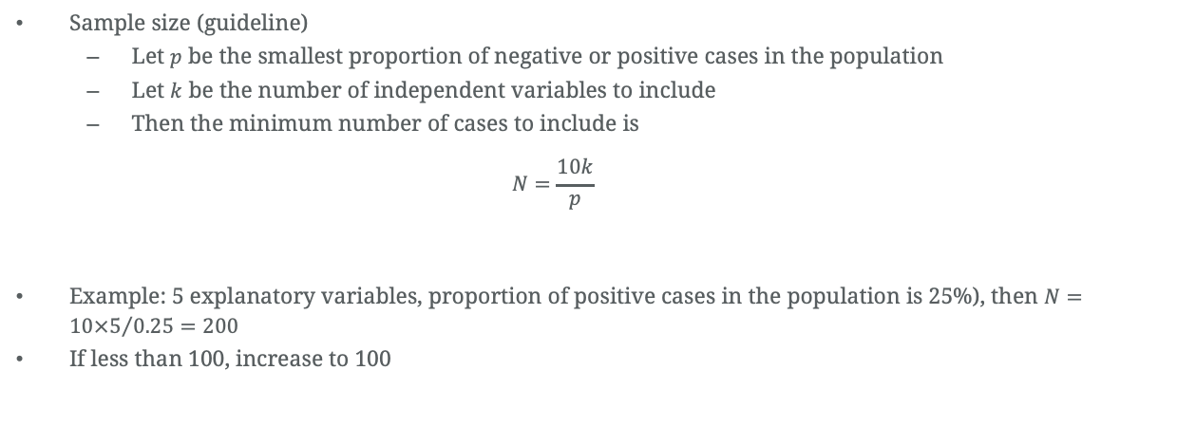
Odds and ends
Sample size (guideline)
Let $p$ be the smallest proportion of negative or positive cases in the population
Let $k$ be the number of independent variables to include
Then the minimum number of cases to include is
$$N=\frac{10k}{p}$$
Example: 5 explanatory variables, proportion of positive cases in the population is 25%), then $N={10×5}/{0.25}=200$
If less than 100, increase to 100
An introduction to logistic regression: from basic concepts to interpretation with particular attention to nursing domain (Park 2013)

Slide 101
Odds and ends
Univariable – one explanatory variable
Univariate – One response variable
Multivariable – more than one explanatory variable
Multivariate – more than one response variable
Multivariate or Multivariable Regression? (Hidalgo and Goodman)

Slide 102
References
Understanding logistic regression analysis (Sperandei)
Using logistic regression in perinatal epidemiology: an introduction for clinical researchers. Part 1: basic concepts (Brand, Keirse)
An introduction to logistic regression with an application to the analysis of language recovery following a stroke (Greenhouse et al)
Explaining Odds Ratios (Szumilas)
Penn State, STAT 504, Binary Logistic Regression

Slide 103

Thank You

